Slide 1
Tenements and the Problems of Overcrowding

Slide 2
Tenements
Dramatic population growth; Immigrants arrived faster than ability to build housing

Slide 3
Population Growth, Chicago
Census | Population | % Growth
1840 | 4,470 | --
1850 | 29,963 | 570.3%
1860 | 112,172 | 274.4%
1870 | 298,977 | 166.5%
1880 | 503,185 | 68.3%
1890 | 1,099,850 | 118.6%
1900 | 1,698,575 | 54.4%

Slide 4
Tenements
Dramatic population growth; Immigrants arrived faster than ability to build housing
Apartments crammed in more people than designed to house; known as Tenements
House working class and immigrants
By 1865, in NY, more than 500,000 people lived in 15,000 crowded unsanitary tenements
James Ware and dumbbell design (Old Law)
First law to attempt to regulate housing
Regulate space between apts, ventilation, fire escapes

Slide 5
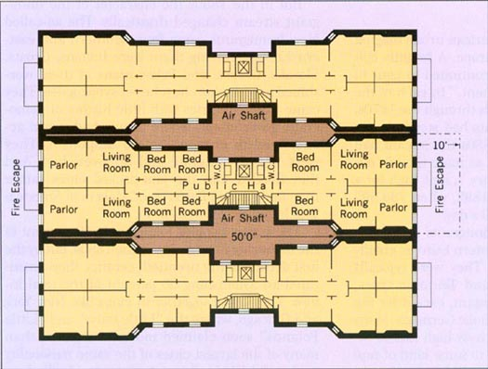
Dumbbell Design
Notes:
Air shafts filled up with waste; made problem worse not better.

Slide 6
Tenements
Dramatic population growth; Immigrants arrived faster than ability to build housing
Apartments crammed in more people than designed to house; known as Tenements
House working class and immigrants
James Ware and dumbbell design (Old Law)
Conceals huge engine of upward mobility
Most immigrants only stayed a short time;
Ghettos created when people locked into tenements due to discrimination

Slide 7
Problems of Overcrowding
Most tenements had little or no ventilation
Whole families would live in a single room
Many lived in basement apartments
Walls a mat of slime, sewage, and moisture
Often flooded with sewage
Inadequate privies
Less than 6 ft from building, not connected to sewers
E.g., Two story building housing 102 people with only one privy

Slide 8
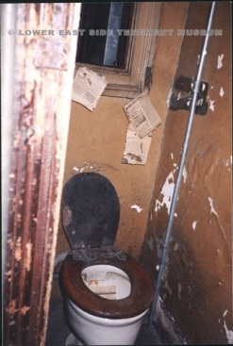
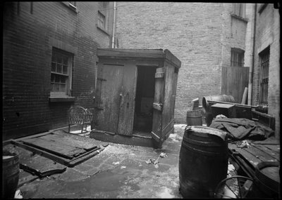
Tenement Privy
Outdoor privy
Indoor water closet

Slide 9
Filth of the City
Urban sanitation was little more than water and a broom – if that!
19th century cities were literally stinking, filthy places
Washington’s Revenge – Europeans thought of diarrhea as the “American Disease”

Slide 10
Filth of the City
Urban sanitation was little more than water and a broom – if that!
19th century cities were literally stinking, filthy places
Chamber pots dumped in streets; cesspits overflowed
1000s of pigs roamed the streets
People did not bathe regularly
Houses adjoined stables, factories, etc.
Even rural areas had manure piles

Slide 11
Miasma and Disease
Most doctors believed that disease caused by rotting filth (the miasma: bad air)
Still, sanitation was ineffective
Street cleaning was a sinecure; did not perform duties
Corruption or incompetence
Filth would be thrown into streets, pile up, or dumped in a river
Sanitation in Jacksonian Era –
Plumbing and sewerage was private
Did not want extra taxation or municipal regulation
Breeding ground for epidemic disease

Slide 12

What is the greatest Medical Achievement since 1840
Notes:
http://www.youtube.com/watch?v=56BhjFDjGCE
Dropbox/video
Poop is dangerous. Handout: “Why Have World Toilet Day”/”Sanitation rated greatest medical achievement” -- in folder

Slide 13
Pooping in America
History of Urban Sanitation Reform
Notes:
(Note: This lecture is still being revised and subject to change)

Slide 14
Colonial Era
“The Past is a Foreign Country”
Very little is known about “habits of elimination” in early colonial era
Chamber pots not on list of supplies
Imported Chamber Pots; most common artifact after mid-17th century
Notes:
Note to self: This section looks longer than it is; only takes about 40 minutes without questions.

Slide 15
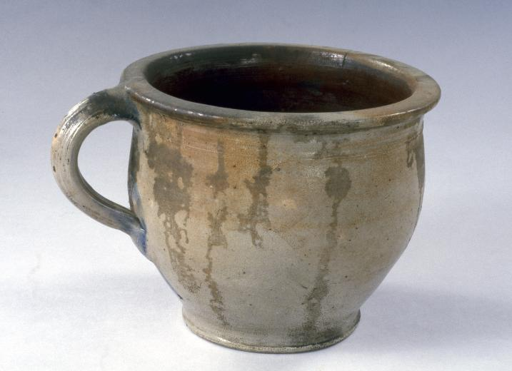
Chamber Pots

Slide 16
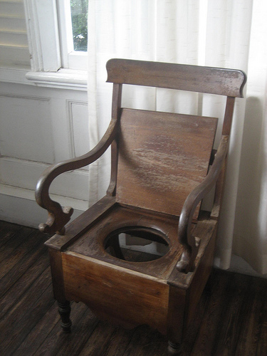
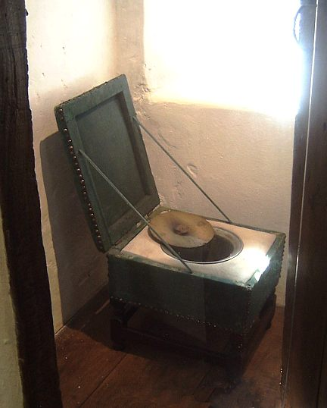
Chamber Pot Chair/ Close-stool

Slide 17
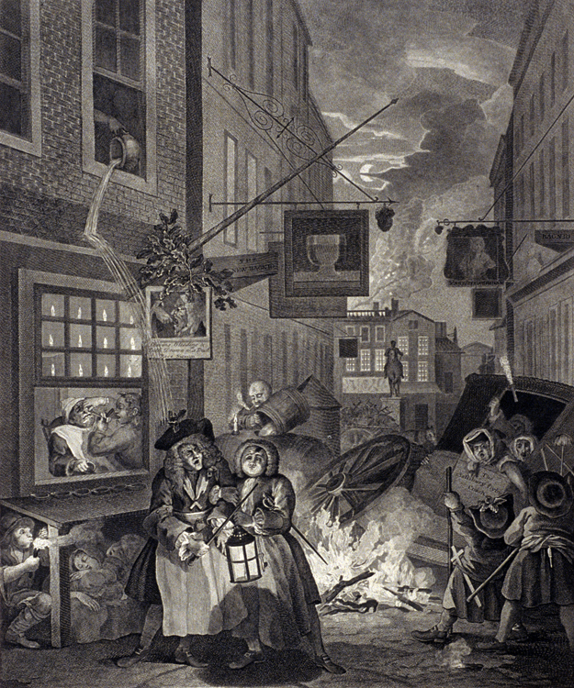
Hogarth, The Night

Slide 18
The Necessary
Eventually outdoor privy will be constructed
Used by Americans as late as 1950s
Placed in back far away
Many did not have pits, but rather pails or drawers were used
Would have to be cleaned and emptied; usually by slaves or servants

Slide 19
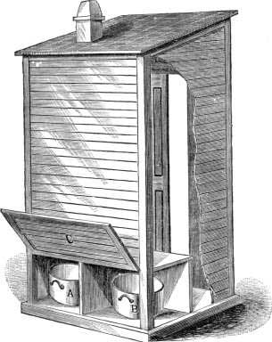
Pail Privy

Slide 20
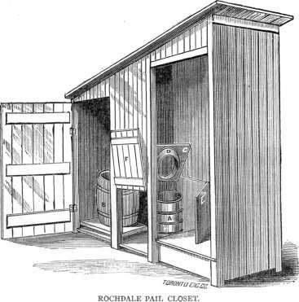
Rochdale Pail Closet

Slide 21
The Necessary
Placed in back far away
Privy vaults lined with stone or brick
Leech into surrounding soil;
In cities, privies are close to water supply; often enter water wells
Where land was plentiful privies would be filled in and moved
Wealthy would construct nice, permanent buildings

Slide 22
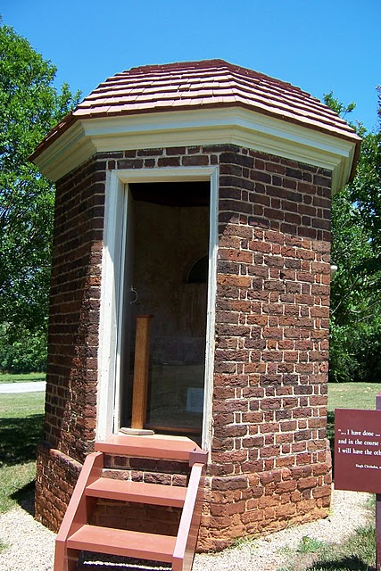
Privy at Montecello

Slide 23
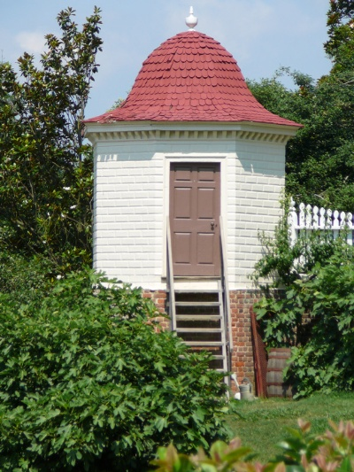
Privy at Mt Vernon

Slide 24
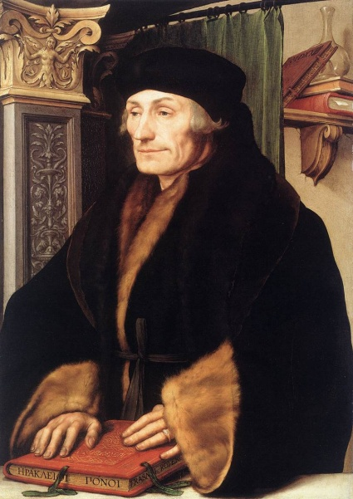
What Privacy?
“It is impolite to greet someone who is urinating or defecating.”
Erasmus of Rotterdam
On Civility of Boys, 1530
Expectations of privacy very different from today
Little qualms about performing bodily functions in public
The Civilizing Process
by Norbert Elias.

Slide 25
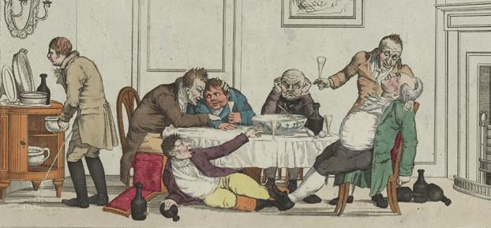
What Privacy?
Little qualms about performing bodily functions in public
Chamber pots placed in full view, bedroom and dining rooms; never given its own room
Multi-seat privies not uncommon

Slide 26
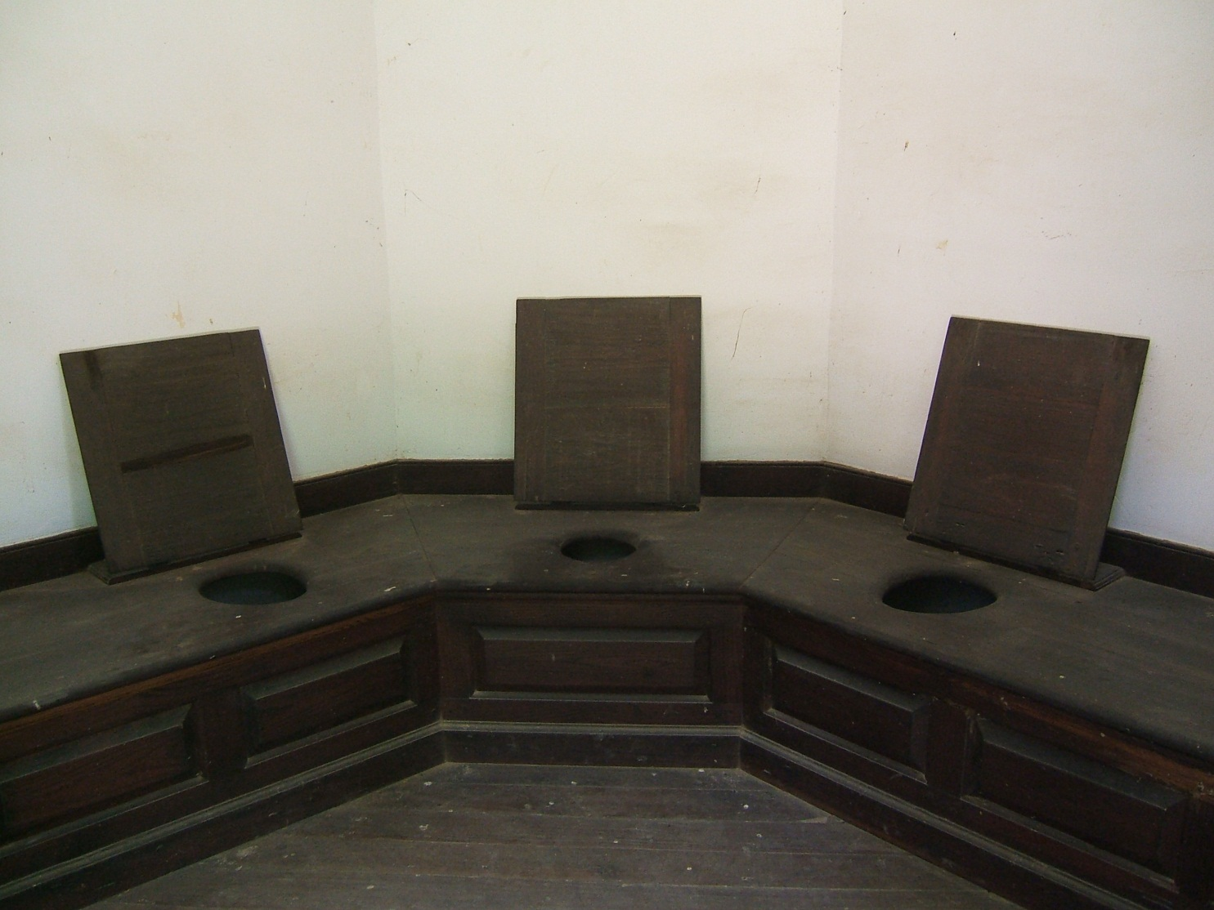
Three-seat Privy at Mt Vernon

Slide 27
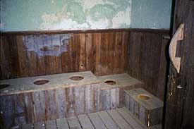
Five-seat Privy at Colonial Williamsburg

Slide 28
Lady’s Room/Men’s Rooom
Modern notions of privacy develop at end of 18th century
Bodily functions once viewed as natural and inevitable, Victorians viewed as something to be hidden and ignored
Furniture to hide chamber pot
Separated by gender (begun in Paris, 1739)

Slide 29
All the Modern Conveniences
Indoor water-closets unknown in Colonial era
Appear in Philadelphia by late 18th century;
did not catch on – smelly, noisy, difficult to clean
Water-closets and plumbing increasingly common by mid-19th century in middle and upper-class homes
Notes:
Ogle, Maureen. All the Modern Conveniences: American Household Plumbing, 1840-1890.

Slide 30
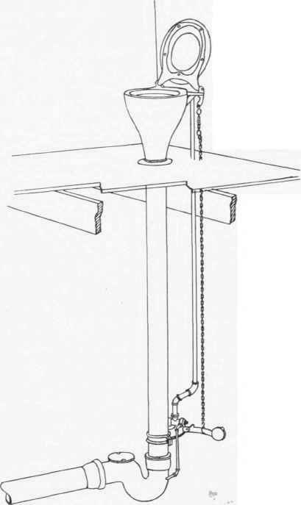
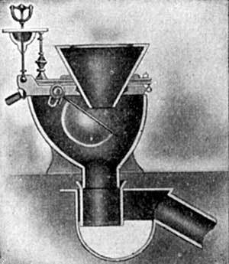
Early Water Closets
Pan Closet
Hopper Closet
Notes:
Handout: “Flush Toilets and the invention of the 19th century bathroom”

Slide 31
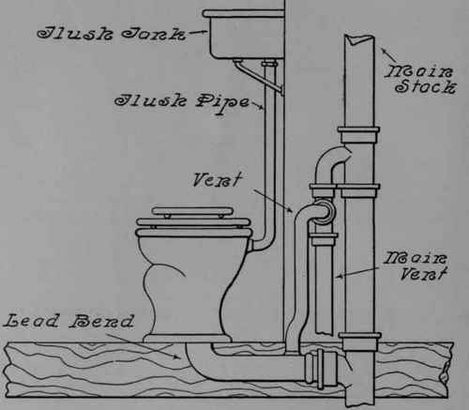
Flush Water Closet

Slide 32
All the Modern Conveniences
Indoor plumbing associated with class, not hygiene
Convenience was watchword of the day
Connection between hygiene and disease not understood

Slide 33
All the Modern Conveniences
Central waterworks increase between 1840 and 1870
Not intended for domestic consumption

Slide 34
All the Modern Conveniences
Central waterworks increase between 1840 and 1870
Use of plumbing without connecting to waterworks
Private wells or rain water collected in cisterns

Slide 35
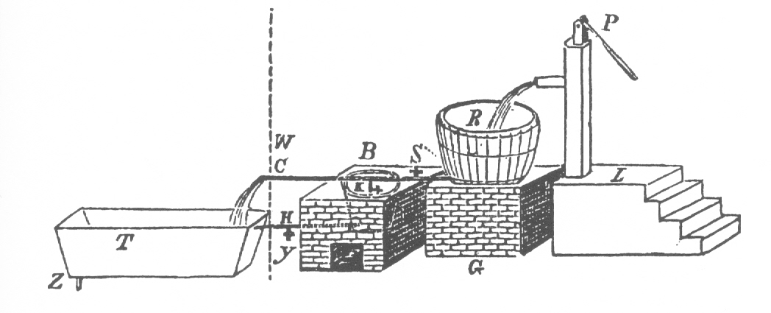
Household Plumbing

Slide 36
All the Modern Conveniences
Central waterworks increase between 1840 and 1870
Use of plumbing without connecting to waterworks
Waste piped into cesspits located in basement or backyard
Problems with 19th century plumbing & increased water usage
cesspits to overflow and flooded into streets
Faulty pipes leaked sewer gas

Slide 37
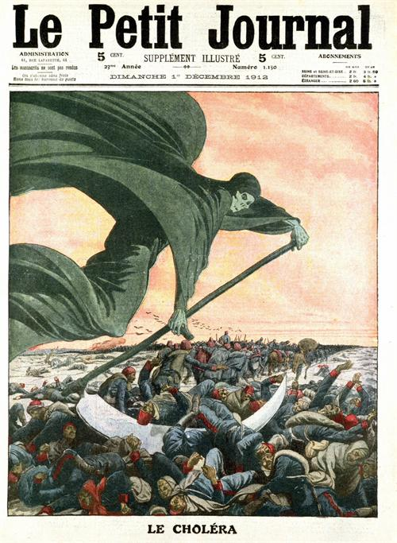
The Cholera Years
Notes:
Charles E. Rosenberg, The Cholera Years: The United States in 1832, 1849, and 1866. The University of Chicago, 1962.
John Aberth, Plagues in World History.
Christopher Hamlin, Cholera: The Biography.
http://www.nlm.nih.gov/exhibition/cholera/images.html
(note: this lecture is still being revised)

Slide 38
Story Time
James Gilligan , 20 Orange Street
Notes:
Charles Rosenberg. The Cholera Years: 1832, 1849, and 1866.

Slide 39
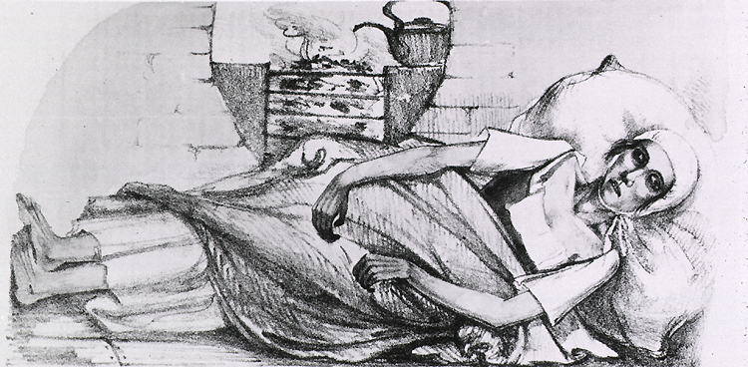
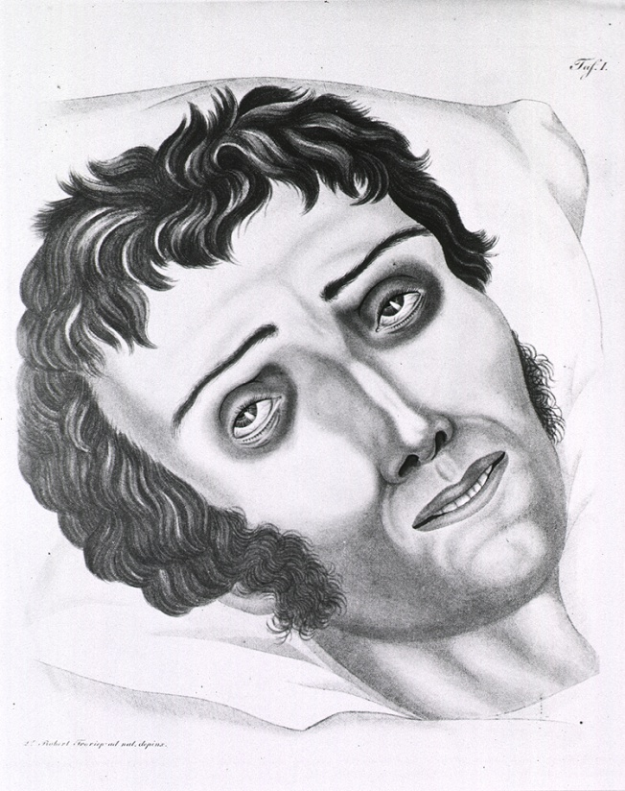

Slide 40
Historiography of Cholera
Understand entire 19th century through lens of Cholera
Unintended consequence of urbanization and mass migrations
Understand 19th century politics, religion, and medicine by its response to Cholera
Gave rise to sanitary reform, public health movement, and foreshadowed progressivism
Study social history, medical history, etc.

Slide 41
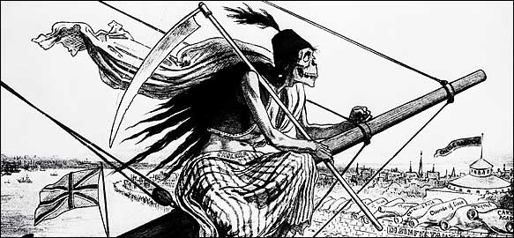
Classic Disease
Parallel to Plague of the 14th century
No evidence of Cholera in West prior to 19th century
Unwelcome side effect of imperialism, transportation revolution, and urbanization

Slide 42
Classic Disease
Parallel to Plague of the 14th century
No evidence of Cholera in West prior to 19th century
Unwelcome side effect of imperialism, transportation revolution, and urbanization
Pandemics of Cholera in 19th Century
Fearful of Cholera more than any other disease

Slide 43
Antebellum Cholera Epidemics: 1832 and 1849
Americans assumed they would be immune
Most likely brought by steerage passengers; quarantine was limited and ineffective
Middle and upper classes flee the city
Disease spreads rapidly; hardest hit were tenements
5,000 in New York and 3,500 (5%) dead in Chicago
Est. 150,000 nationwide

Slide 44
Bring out your Dead
19th century hospitals
No one would rent property for a cholera hospital
Used public schools instead
Little better than butchers
Distrust of doctors and hospitals
Unable to bury bodies fast enough
Dead bodies would lay on ground for days
Buried in shallow potters field
Rats would devour bodies before they even decomposed
Carcasses of dead animals posed significant problem
Bone boilers shut down; carcasses and offal dumped in rivers

Slide 45
Bring out your Dead
Unable to bury bodies fast enough
Carcasses of dead animals posed significant problem
Bone boilers shut down; carcasses and offal dumped in rivers
Cholera flared on immigrant barges and steamboats
So crowded sick could not even lay down
Dead bodies simply dumped over board

Slide 46
Bring out your Dead
Unable to bury bodies fast enough
Carcasses of dead animals posed significant problem
Bone boilers shut down; carcasses and offal dumped in rivers
Cholera flared on immigrant barges and steamboats
Death toll between 10 – 50 % of city populations

Slide 47
God’s Justice
Cholera as an inescapable and inevitable consequence of sin
Intemperance, impudence, and filthiness
Divine justice – like the flood
Reality of disease seems to bear this out
Cholera hits mostly prostitutes, drunks, and low people
To die of cholera was to die in suspicious circumstances

Slide 48
God’s Justice
Cholera as an inescapable and inevitable consequence of sin
Reality of disease seems to bear this out
Cholera hits mostly prostitutes, drunks, and low people
To die of cholera was to die in suspicious circumstances
Proclamations for Days of Prayer and fasting

Slide 49
Man’s Injustice
Cholera revealed the extent of misery and poverty in America
Worst Sufferers
African-Americans
New Immigrants, especially Irish
Radicals advocate end of poverty and ignorance to get rid of future epidemics

Slide 50

Medical Profession
Doctors not well respected in 19th century
Medical schools were open to anyone who could pay tuition
Unable to cure most diseases
Cure was worse than the disease
“resurrectionists” – grave robbing
Burke and Hare murders

Slide 51
Medical Profession
Unable to prevent or cure Cholera
hurt already damaged reputation
People would avoid doctors
Pre-disposing causes & Miasma
Accepted Treatments of the day
Bloodletting
Laudanum (tincture of opium)
Tobacco smoke enema
Plugging rectum with beeswax or oilcloth

Slide 52
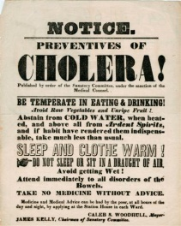

Slide 53
Quacks and Patent Medicines
Quacks and home remedies flourished
Newspapers printing remedies were quickly sold out
Drug stores circulated handbills
Cholera specific medicines quickly concocted and sold

Slide 54
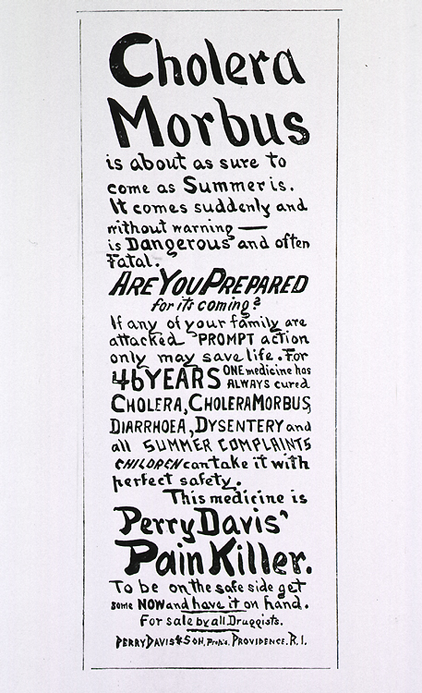

Slide 55
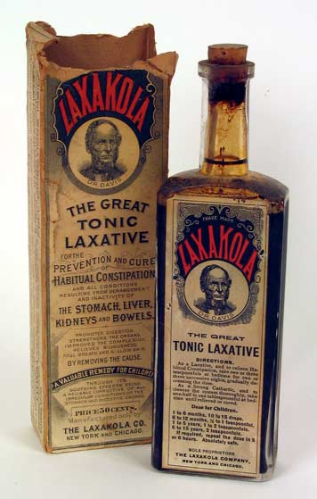
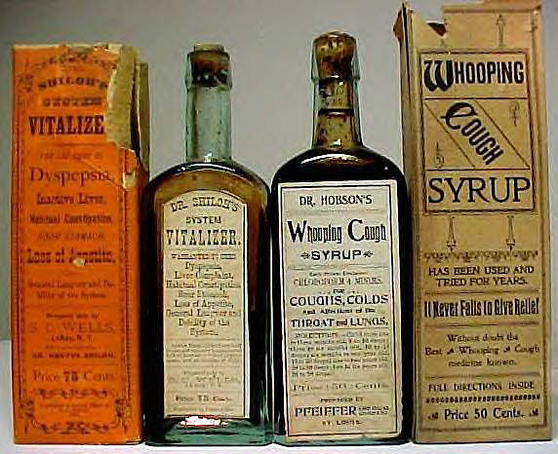

Slide 56
The Sanitarians
Sanitation Reform

Slide 57
John Snow and the Broad Street Pump
Story Time

Slide 58
John Snow and the Broad Street Pump
Pioneer in anesthesiology
Practiced in Soho during Cholera Epidemics
Began statistical survey of the disease
Ghost Map
Determined that cholera was spread by contaminated water at Broad Street pump
Notes:
Steven Johnson, The Ghost Map: The Story of London’s Most Terrifying Epidemic – and How it Changed Science, Cities, and the Modern World.
http://www.theghostmap.com/

Slide 59
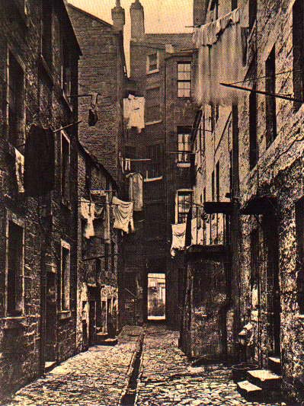

Slide 60
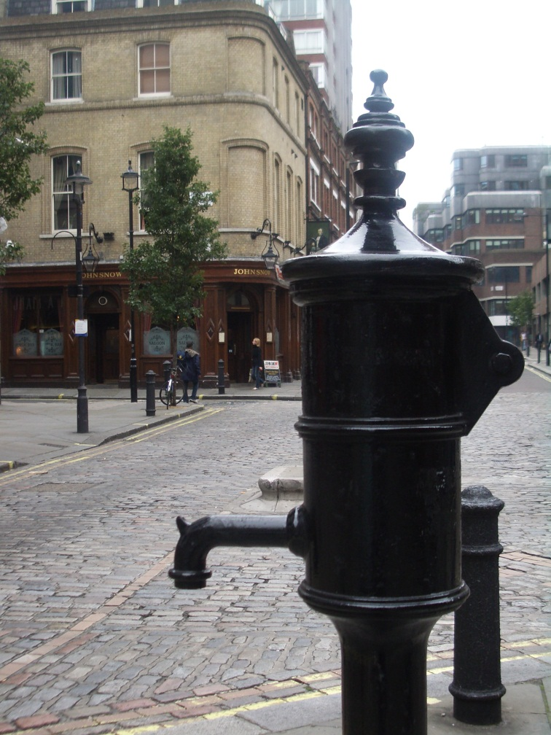
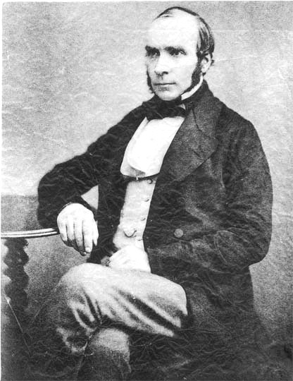

Slide 61
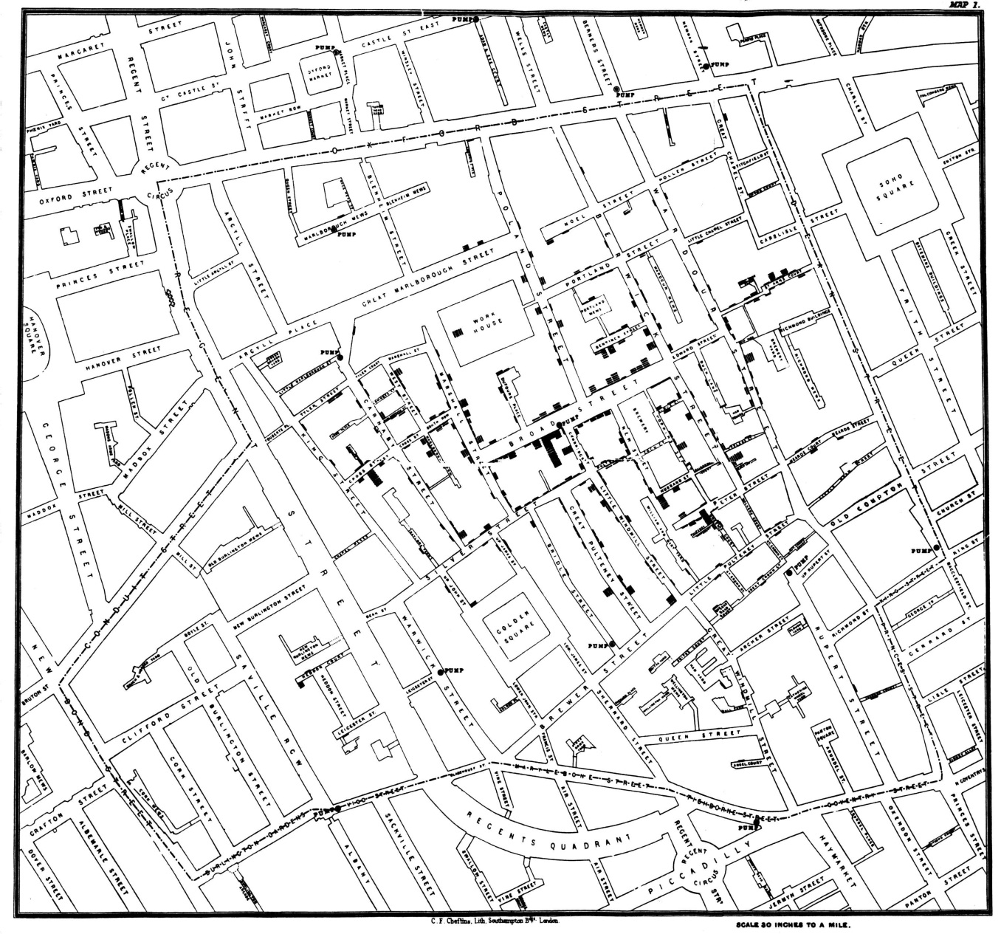
Snow’s Map

Slide 62
The Sanitarians
Edwin Chadwick
The Sanitary Condition of the Labouring Population (1842)
U.S. Sanitary Commission (1861)
George Waring

Slide 63

Tenements and George Warring

Slide 64
Metropolitan Board of Health
By 1866, ideas of John Snow were widely accepted by American physicians
Metropolitan Board of Health organized
First time an American community organized itself to combat epidemic
Began preparing for Cholera
Forced contractors to clean streets
Removed 160,000 tons of manure removed
6,500 privies disinfected

Slide 65
Metropolitan Board of Health
By 1866, ideas of John Snow were widely accepted by American physicians
Metropolitan Board of Health organized
First time an American community organized itself to combat epidemic
Began preparing for Cholera
Only by such labors could a city protect itself from epidemic
Call for similar boards in other cities

Slide 66
Gospel of Public Health
Disease could not be cured, but it could be prevented
Clergy also beginning to think in terms of environment
Social Gospel Movement
Moralistic causation increasingly rejected by medical science
Cholera was the catalyst to the public health movement

Slide 67
The Sanitarians & Public Health
Science of preventing disease and promoting health through organized community efforts
Private plumbing and cesspools now seen as dangerous
Plumbing leaks sewer gases
Advocate for sanitary sewers & cleanliness
Sewage must be carried away from the cities
Advocate government regulation and intervention
Paves the way for Progressives
Notes:
Sewage must be carried away from the cities – mostly dumped into rivers. Not until germ theory accepted will sewage treatment make sense.

Slide 68
Paradigm Shift
Paradigm: a worldview underlying the theories and methodology of a particular scientific subject
Miasma to Germ Theory
John Snow
Louis Pasteur
Robert Koch
Sewage Treatment
Notes:
Good example of paradigm is calories in/calories out model of weight loss vs. hormonal (carbs and insulin).

Slide 69
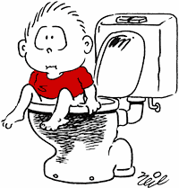
Now Wash Your Hands!

